Slide 1
TPS Case Competition
Team Co-MMA
November 26, 2020
Prepared by Humza Butt, Kevin Zhang, Alan Liu, Devashree Kumar
Notes:
Humza

Slide 2
Agenda
Toronto Police Service
Executive Summary
Background & Business Problem
Problem Statement
Managerial Question
Analytical Question
Key Data Sources Overview
Exploratory Analysis
Further Analysis
Modeling Approach
Model Trustworthiness
Key Findings / Recommendation
Next Steps

Slide 3


Executive Summary
TPS Case
Business Problem
Data Used
Reduction of Fatal casualties
Reduction in # of Severe injuries
Address safety of most vulnerable users of the transportation system
Pedestrians, cyclists, adults, teens and etc.
Dataset Name | Description
KSI Data | Traffic Collision: Killed or Seriously Injured (KSI) from 2006 – 2019
Reported Crime | Auto Theft, Break and Enter, Robbery and Theft from 2014 – 2019
Main Findings
Recommendation
Alcohol and Speeding peaks at 2:00 AM
Rush Hours = Aggressive Driving
Correlation: Crime & Fatal Accidents
Non-fatal Accidents
Fatal Accidents
Use Dashboard
Predict the fatal beforehand to allow for officers to act more urgently.
Allocate resources in specific neighborhoods
Allocate more police force on specific streets for speeding and Alcohol
Notes:
We havent been able to reduce fatal injuries over the years, but we have reduced non fatal injuries
So we need to create a model that detects potential that a crash will be fatal and we can stop it beforehand

Slide 4
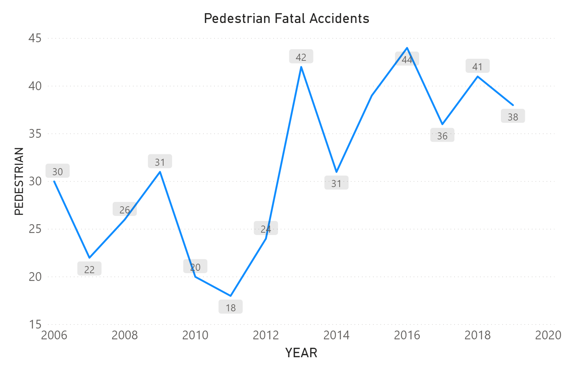
Business Problem
Current Situation
Business Overview
Purpose / Problems
Established in 1834
It was the first local police service created in North America
Primary agency responsible for providing law enforcement and policing services in Toronto
318 fatal & non-fatal injuries in Toronto for 2019.
Non-fatal injuries - Declining
Fatal traffic accidents - Consistent
Due to limited resources, device smarter ways to reduce traffic related injuries and fatalities.
Vision Zero Plan
Comprehensive 5-year (2017-2021) action plan focused on reducing traffic-related fatalities & serious injuries
About 10% reduction in pedestrian fatalities from 2013 to 2019
Vision Zero Plan
Objective : The city of Toronto is committed to reduce traffic-related deaths & injuries to zero.

Slide 5
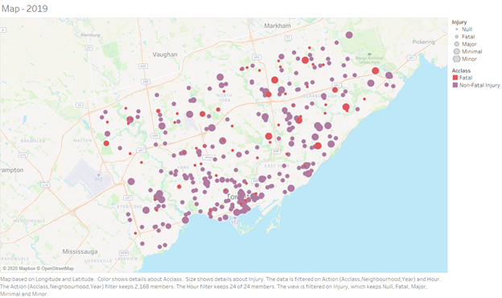
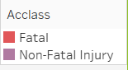
Managerial and Analytical Objectives
Problem Statement
Managerial question
How can TPS reduce fatality and serious injuries related to traffic accidents?
Who/What should TPS focus their resources? What safety measurement can TPS implement?
How can TPS evaluate these implementations?
Analytical question
What are the significant variables that impact the likelihood of an accident being Fatal or Non-Fatal?
What are the external factors that influence traffic accidents?
2019 Traffic Fatality Map

Slide 6
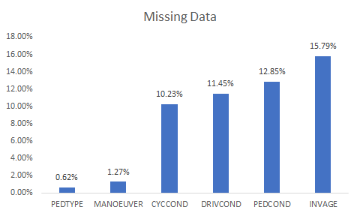
Key Data Sources
Handling Data
Problems in Data
Data Sources Used
Missing value “unknown” and various empty cells.
Created indicator variables of variables where only “Yes” is shown and the rest is blank.
Handle missing data by keeping missing data and categorizing as its own factor.
Dataset Name | Description
KSI Data | Traffic Collision: Killed or Seriously Injured (KSI) from 2006 – 2019
Reported Crime | Auto Theft, Break and Enter, Robbery and Theft from 2014 – 2019
Description of Data
Single row represents an individual that was involved in a traffic accident at a certain point of time.
ACCNUM is a unique ID that represents a single traffic accident.
There can be multiple individuals in an accident, but only one accident per individual.
Notes:
Humza

Slide 7
Exploratory Analysis

Slide 8
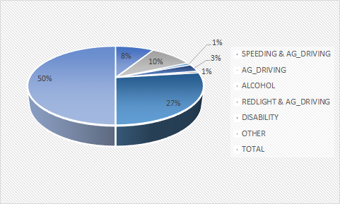
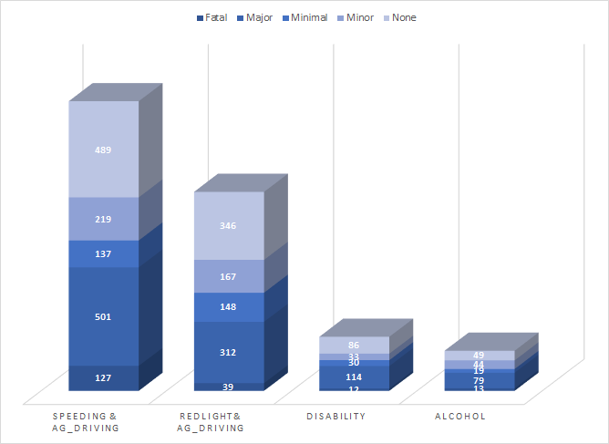
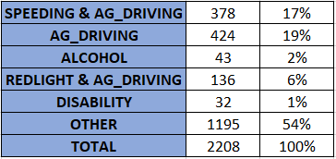
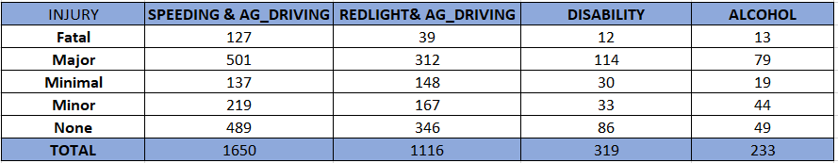
Exploratory Stage
Causes of Fatalities
Causes of Injury

Slide 9
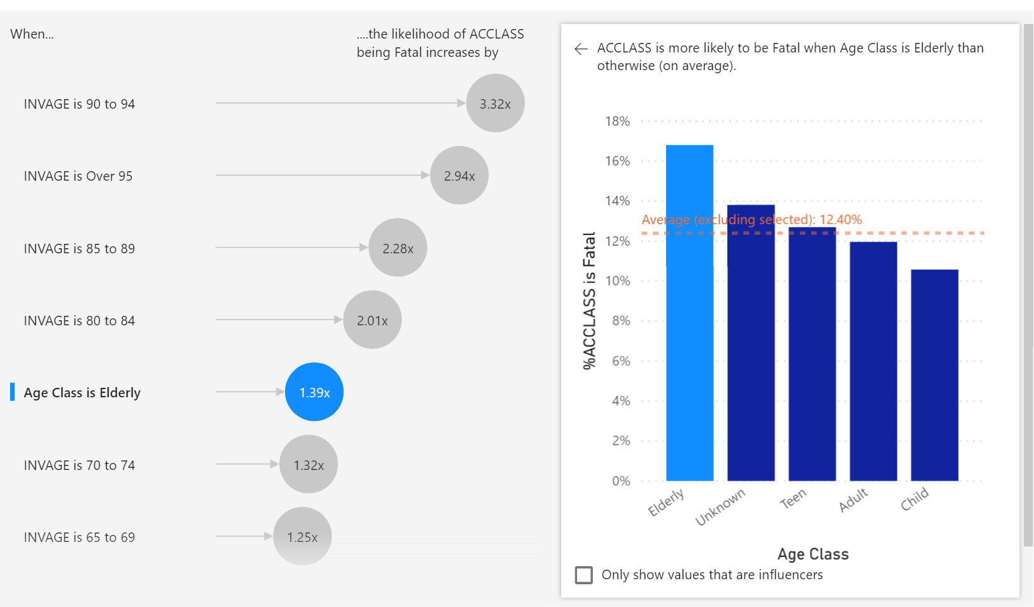
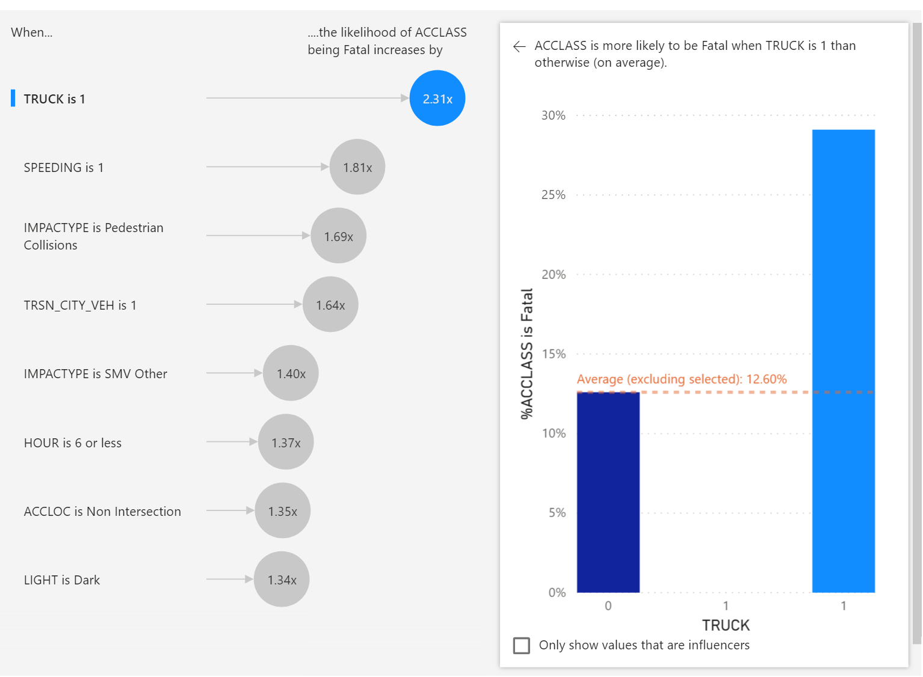
Exploratory Stage
What are the factors that are highly related to fatal accidents?
Age
Other Factors: Truck, Speeding, Collision Type...
Age Class:
Variable derived from INVAGE.
Factor variables (eg. Truck):
1 means the accident involves truck.

Slide 10
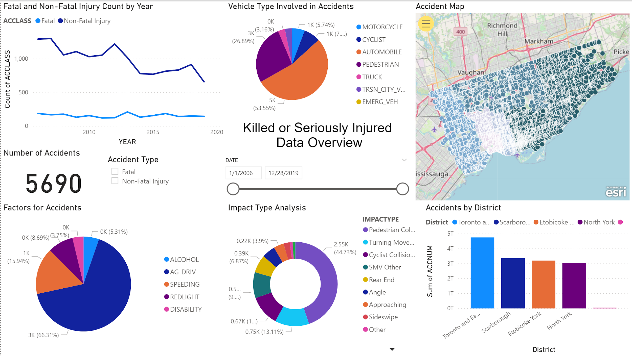
Dashboard
Overview
Graph for Fatal and Non-Fatal Injury Count by Year
Pie chart for the type of vehicle involving in accidents (cyclist, truck, etc.)
Accident Map (color indicate districts)
Filter for
Fatal & Non-Fatal
Date Slicer (select date range)
Total Accident #
Bar chart for Accidents by Districts
Pie chart for the factors involving in accidents (alcohol, speeding, etc.)
Pie chart for the impact type
Notes:
5 humza
3 dashboard
4 kevin
5 devasharee
3 alan

Slide 11
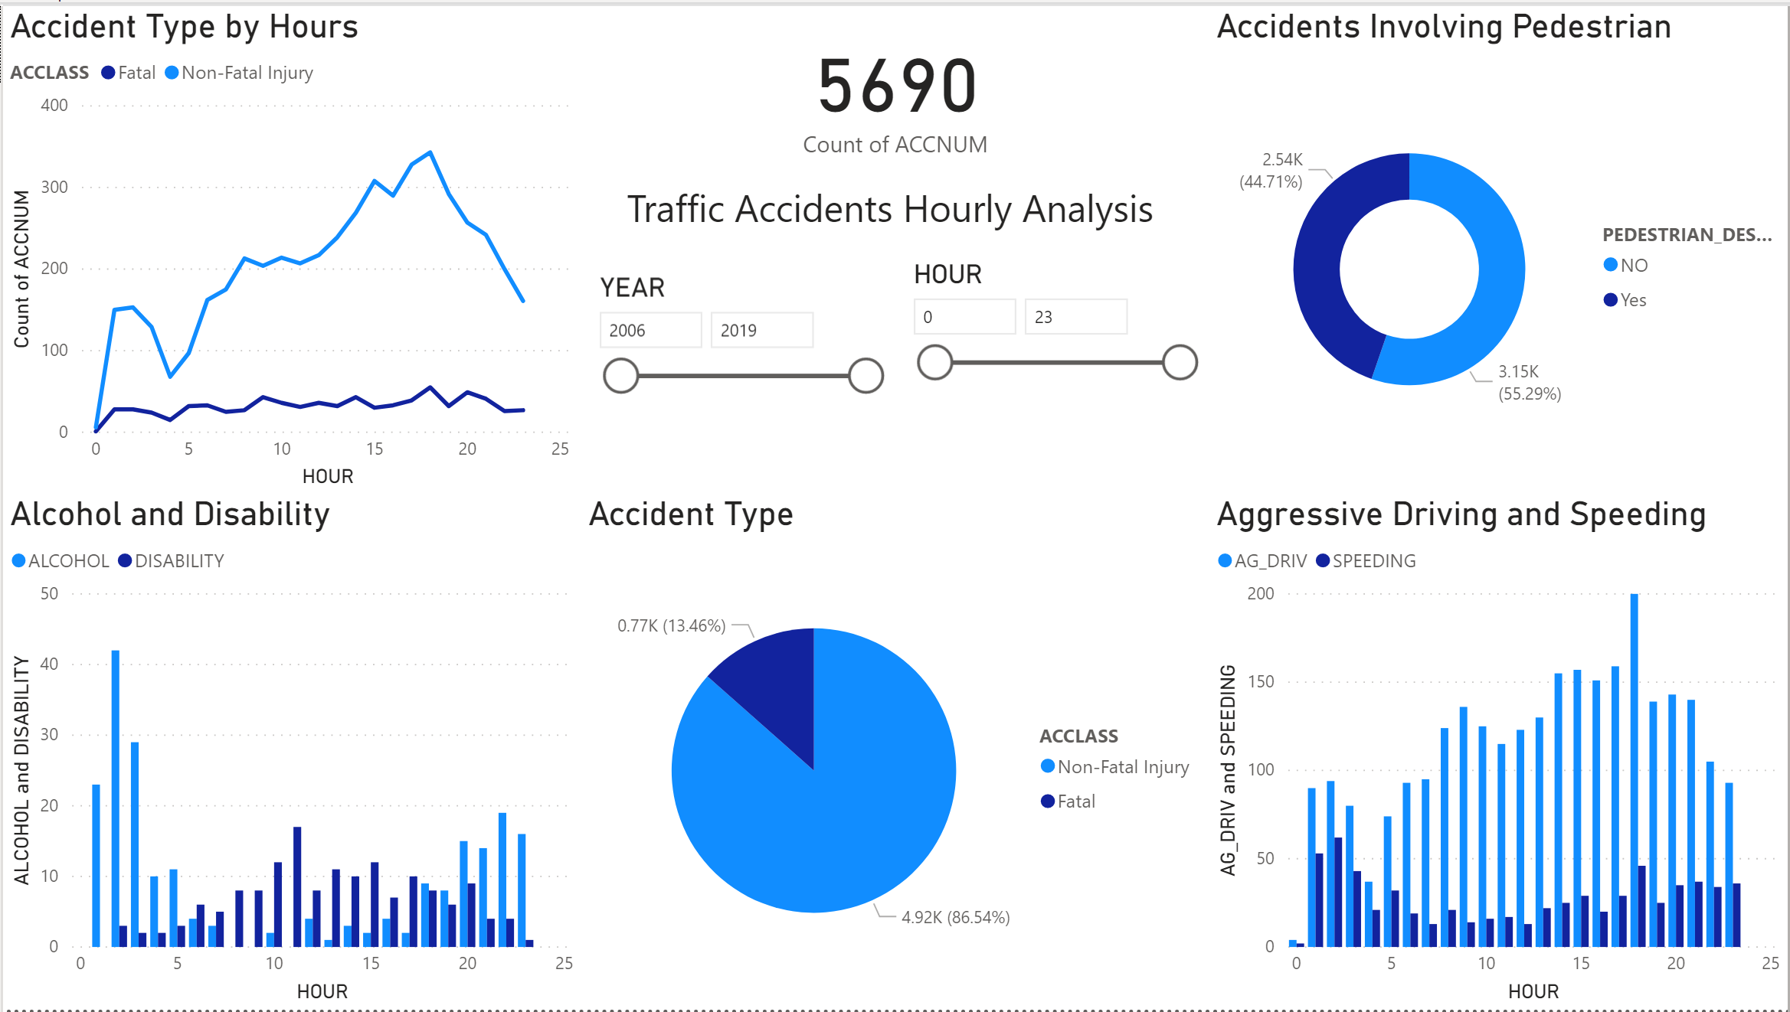
Dashboard
Hourly Analysis
Number of Accident type by hours (Fatal vs. Non-Fatal)
Number of Accident that involves Pedestrians
Number of Accident involving Alcohol and Disability by hours
Number of Accident involving Aggressive Driving and Speeding by hours
Number of Accident type (Fatal vs. Non-Fatal)
Alcohol Consumption and Speeding related accidents peaked at 2 am
Aggressive Driving related accidents peaked at 9 am and 6 pm (Rush Hours)
Disability involved in accidents majority during daytime.

Slide 12
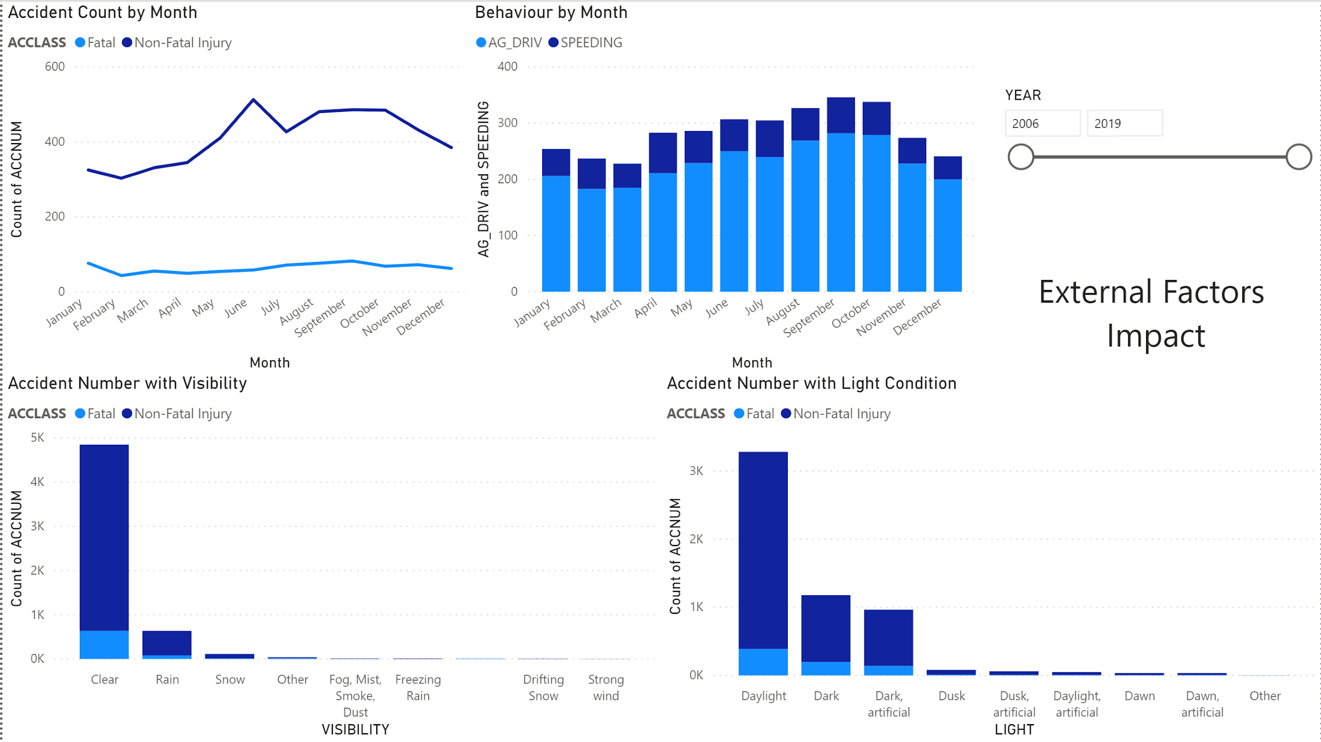
Dashboard
External Factors
Fatal accidents consistent throughout the seasons
Road condition does not significantly contribute fatal accidents
Drivers are less aggressive in Winters (where the road condition is bad)
Number of Accident type (Fatal vs. Non-Fatal)
Number of Accident type by Month (Fatal vs. Non-Fatal)
Number of Accident with respect to Light
Number of Accident with respect to Visibility

Slide 13
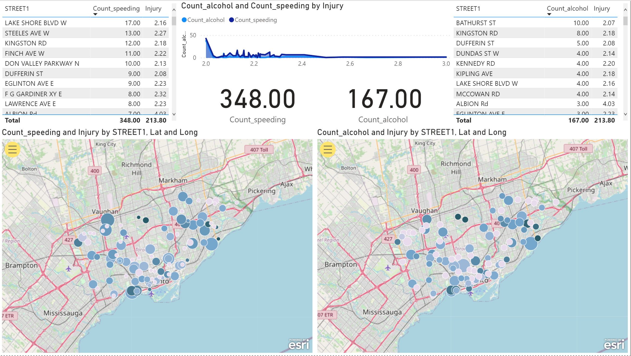
Dashboard
Street Analysis
Graph with the seriousness of injury related to Speeding and Alcohol
Counts related to speeding and alcohol cases
List of Street with most speeding related accidents
List of Street with most alcohol related accidents
Street Map involving Speeding (size indicates the cases of speed related accidents)
Street Map involving Alcohol (size indicates the cases of speed related accidents)

Slide 14
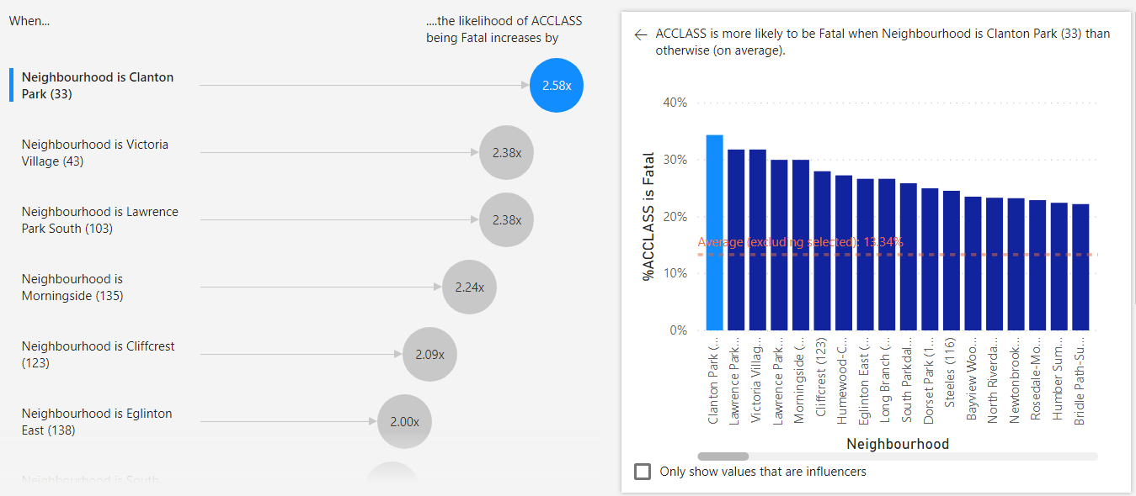
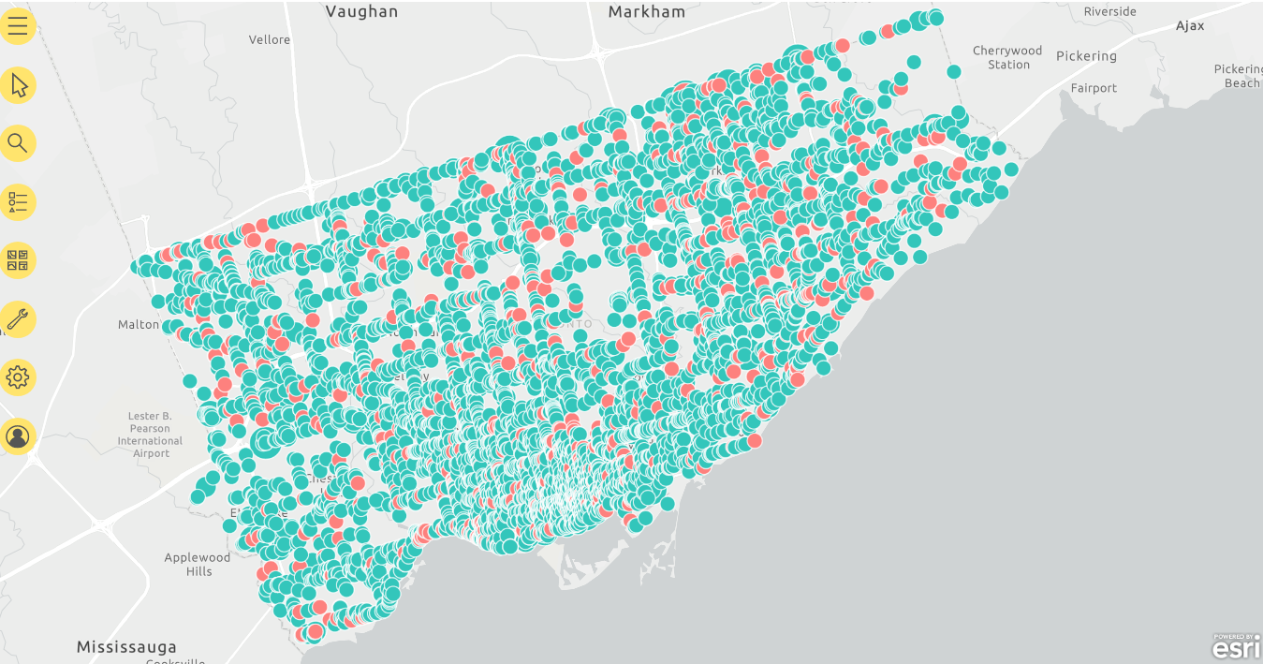
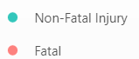
Dashboard
Streetwise Fatality Analysis
Neighbourhood Analysis
Fatal & Non-Fatal Injury Analysis
4 neighbourhoods with highest likelihood of Fatal accidents - Clanton Park, Victoria Village, Lawrence Park(S) & Morningside

Slide 15
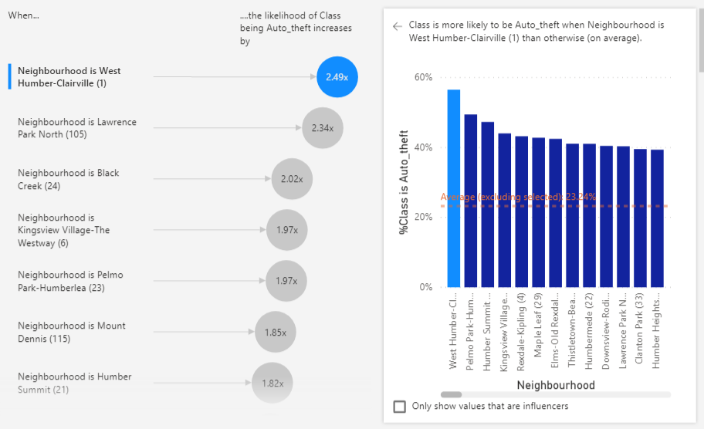
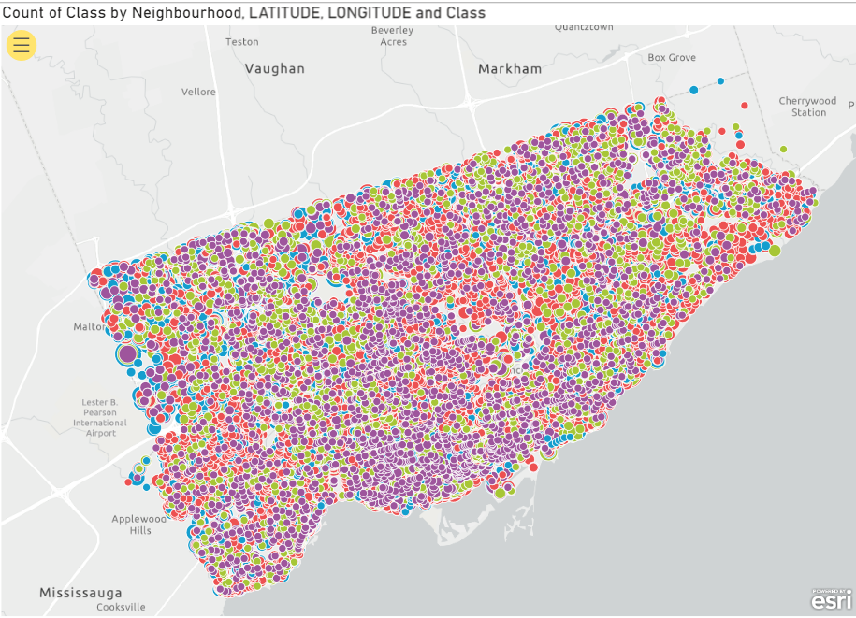
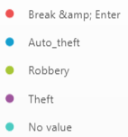
Dashboard
Streetwise Crime Analysis
Likelihood of crime in neighbourhood
Analysis of various crimes in different neighbourhoods
4 neighbourhoods with highest likelihood of fatal accidents are also the neighbourhoods with higher crime.

Slide 16
Modelling Approach

Slide 17
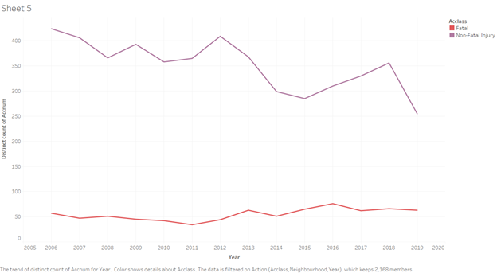
Fatal vs Non-Fatal Injuries
Trends
Fatal and Non-Fatal Injuries over Time
Insight
Non-fatal injury traffic accidents have been steadily decreasing over the years.
Fatal injury traffic accidents have stayed consistent throughout the years.
High Occupancy Toll Act
December 14, 2017
Amendment to Highway Traffic Act
February 9, 2006
Stricter regulations on where cycles should be located
December 11, 2015
Recommendations
Create a model that can be used by officers to determine likelihood an accident may be fatal beforehand.
Data can be collected from 911 calls and can immediately be used to predict likelihood of fatality.
Save lives of those that may not have been immediately killed during a crash, but are likely to be.

Slide 18
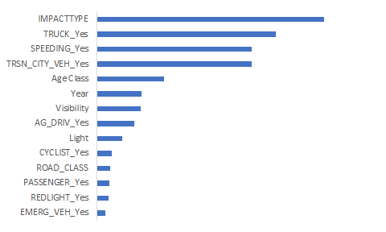
Modeling Approach
Logistic Regression
Model Overview
Model Accuracy
Logistic Regression to determine likelihood of crash being fatal or non-fatal.
Only using variables that can be obtained before officer gets to a collision.
Data was split 70/30 into training and test set to test for overfitting.
 | Training Set | Test Set
Accuracy | 86.85% | 86.07%
False Positive Rate | 12.82% | 13.49%
Predictors and Response Variable
Predictor Ranking by Significance
Predictors
Road Class | Speeding | Age | Visibility | Redlight
Cyclist | Passenger | Emergency | Vehicle | Light
City Vehicle | Truck | Impact Type
Response Variable: ACCLASS

Slide 19
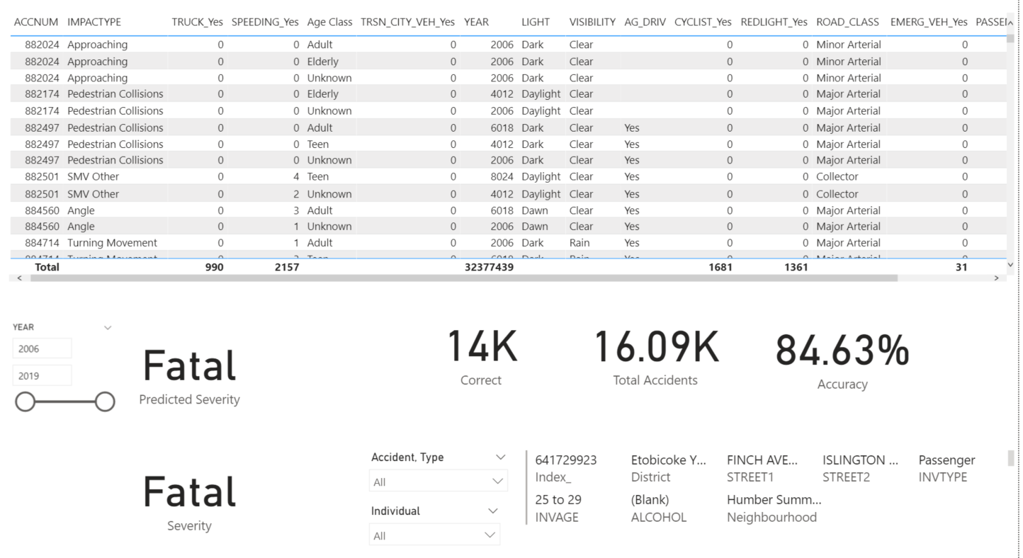
Model Dashboard
Implementation of Model
Interactive Dashboard
Table that represents the type of data needed for the model to make predictions
Accuracy rate of model and absolute value of number of correct predictions
Predicted and actual results of an accident for an individual. Data is adjustable by year
Summary board to describe selected individual and where they were located

Slide 20
Dashboard Demonstration

Slide 21
Conclusion
TPS
Overall Findings
Tactical Recommendations
Non-fatal Accidents
Fatal Accidents
Create a model to predict the likelihood of a traffic accident becoming fatal beforehand to allow for officers to act more urgently.
Allocate resources in neighborhoods where there are higher crimes and higher likelihoods of fatal accidents.
Put more police force on streets where speeding and driving under influence (eg,. Alcohol ) are likely to happen at the specific hours (eg,. 2 am).
Use our dashboard
Significant factors for fatal accidents
Road Class | Speeding | Age | Visibility | Redlight
Cyclist | Passenger | Emergency | Vehicle | Light
City Vehicle | Truck | Impact Type
Aggressive Driving during rush hour, leading to the most accidents.
Alcohol and speeding related accidents occur mostly around 2AM.
Neighborhoods with the most likelihood of having a fatal accident coincide with the ones with the highest likelihood of a crime occuring.
Notes:
With current regulations, non-fatal traffic accidents will decline over time, however fatal accidents have stayed consistent and require intervention.
Impact Type, Speeding, Age, Visibility, Light, Cyclist, Passenger, Redlight, Emergency Vehicle, Road Class, City Vehicle, and Truck are the most significant factors influencing the likelihood of a fatal accident.

Slide 22
Next Steps
Future Considerations
Data Request
Next Steps
Data Request | Reasoning
Data on when a fatality occurred | To determine if fatalities from traffic accidents occurred at the moment of accident or during ambulance ride or hospital. To better utilize the model to save lives.
Variable: Who is responsible for the accident? | Can be useful predictor to determine who is more injured or likely to be in a fatal accident.
Use different modeling algorithms to increase accuracy of predictions and reduce false positive rates.
Discuss with stakeholders about what information should be collected by police for their reports.
Evaluate effectiveness of dashboard and model by using fatality count as a KPI.
Look at legislation and determine the impact of that on accident count in Toronto.

Slide 23
Thank You
Q&A

Slide 24
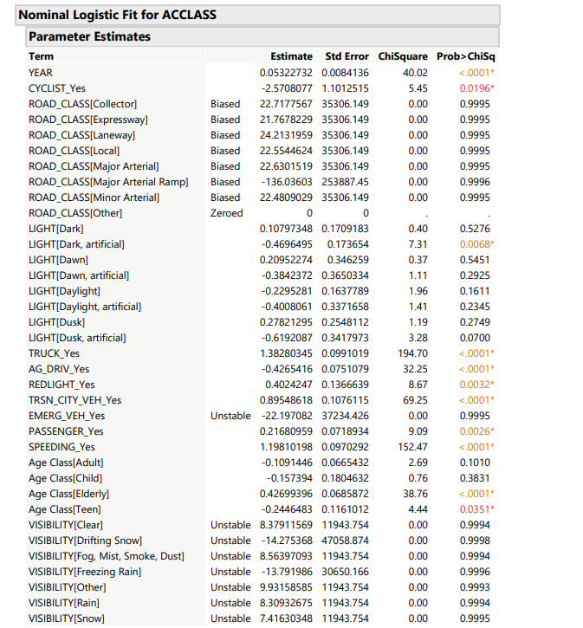
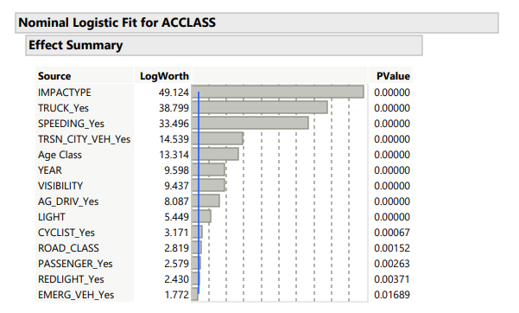
Appendix

Slide 25
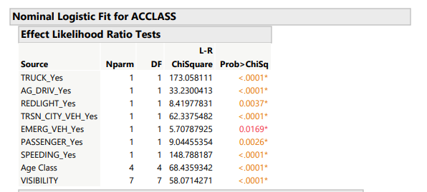
Appendix

